Slide 1
Examining “The Financial Crisis” with Jump Test and HAR-RV Models

Slide 2
Motivation
Examine how jumps and HAR-RV model differ in the financial sector data from 1997 to July 2007 compared to post July 2007 and post September 15 2008

Slide 3
Financial Sector Data
JPM (JP Morgan)
BK (new) (Bank of New York Mellon)
BAC (Bank of America)
AXP (American Express)
ALL (Allstate)
Others Not Included Because of Data Differences

Slide 4
Financial Sector Data
Equally Weighted
Modify data so that stock splits do not affect the RV
Portfolio1: 4/10/1997 through 1/7/2009 (1 share of each stock)
Portfolio2: 4/10/1997 through 1/7/2009 (equally weighted)

Slide 5
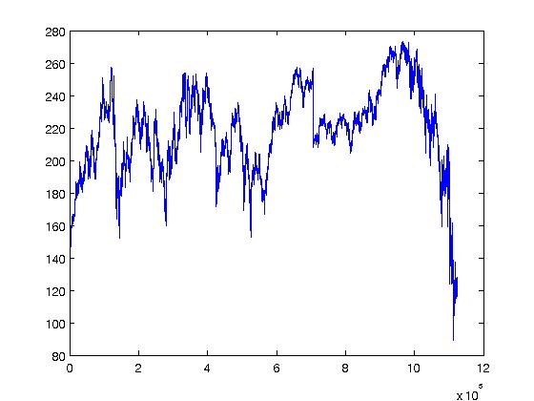
None Weighted Portfolio

Slide 6
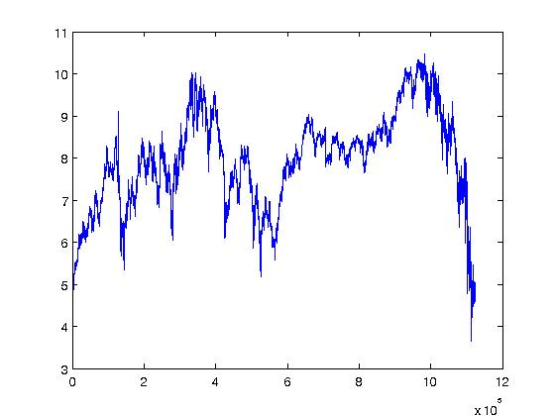
Equally Weighted Portfolio

Slide 7

Jump Test
Compare # of Jump Days as Percentage of Days In All Periods Using Barndorff-Nielsen and Shepard
  Examine for Particular Equities and Financial Porfolio

Slide 8
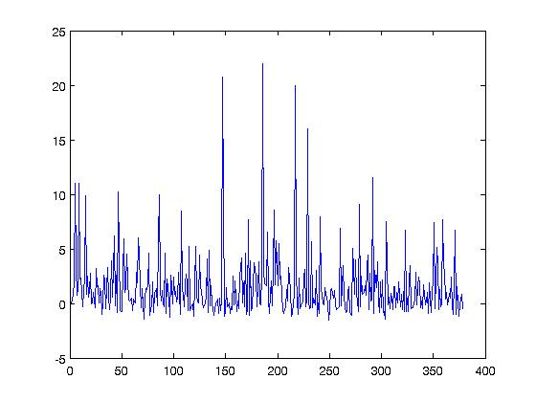
Jumps Post July Non Weighted

Slide 9
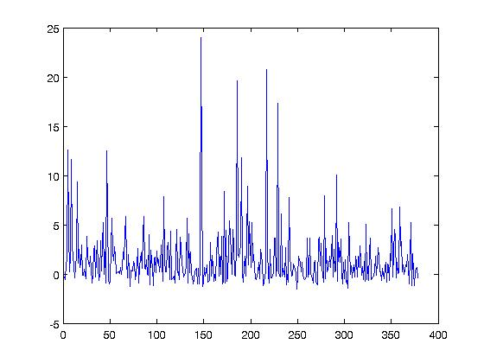
Jumps Post July Weighted

Slide 10
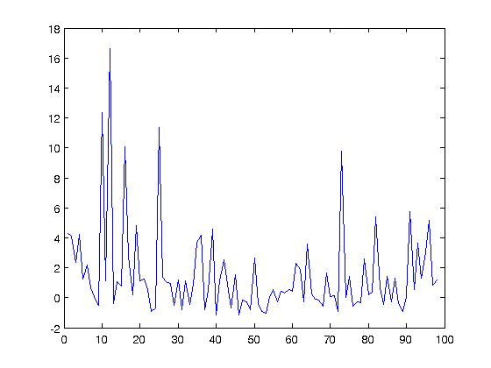
Jumps: After Sept 15 Non weighted

Slide 11
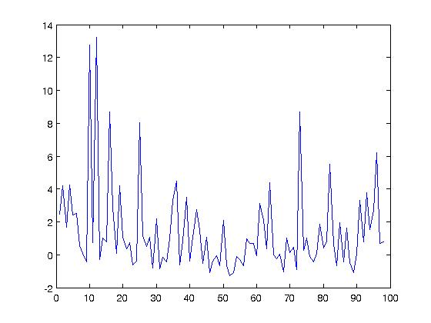
Jumps: Sept 15 Weighted

Slide 12
Results

Slide 13

HAR-RV

Slide 14
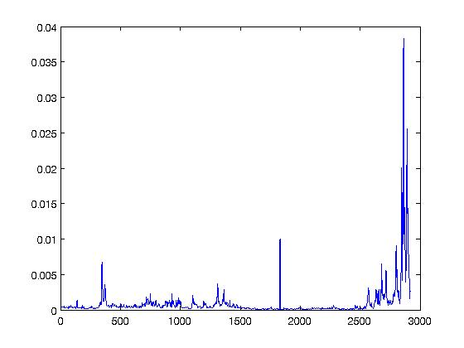
RVJ5

Slide 15
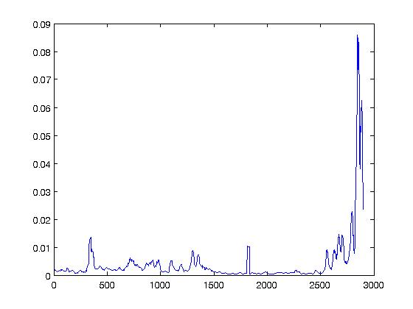
RVJ22

Slide 16
Full Data Set
HAR-RV Coefficients
0.172941459750806
0.0835696683960281
0.0138121594816689
Beta 2.5079e-.05;.17183;.83412;.012887
SE 1.0053e-05;.022303;.0079109,.0017417
t= 2.4947,7.7042;10.544;7.3988
pval=.012662,1.7986e-14;0;1.7897e-13

Slide 18
Conclusion
Jumps have occurred in same probability in “Financial Crisis” as in Rest of Data
HAR-RV model is able to accurately model during “Financial Crisis”
RV is high during “Financial Crisis” but jumps are not occurring at abnormal rate as stated by many in media

